Slide 2
Warm-Up #1
Brainstorm a typical room at school or at your home that contains 10-15 potentially hazardous objects or situations.
Next, identify (List) all the hazards & explain why they are hazardous.

Slide 3
Warm-Up #2 Speeding & unintentional injuries. Fill in the blanks…
Drivers who take their eyes off the road for nearly ______ seconds during an average text, at 55 MPH… a car can travel the distance of a football field in that time.
Automobile unintentional injuries account for ______ % of all deaths in your age group (15-24).

Slide 4
WU #3
When checking for a pulse…
a. What is the name of the artery
b. Location of artery
c. Which artery do we check for a baby, child and adult (they are different)

Slide 5
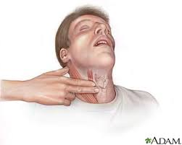
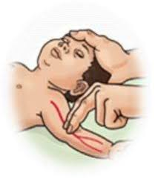
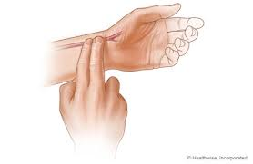
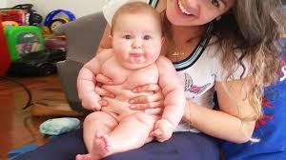
WU #3 ANSWER
a. What is the name of the artery
b. Location of artery
c. Which artery do we check for a baby, child and adult
CAROTID -Adult
BRACHIAL-baby
RADIAL- Child

Slide 6
WU #4 List “tips for proper chest compressions”… How do we do chest compressions differently in a baby, child and adult?

Slide 7
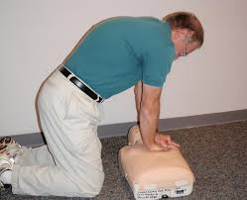
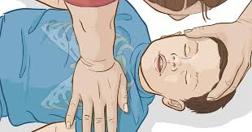
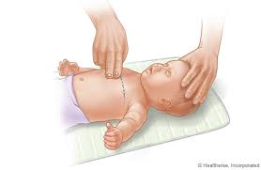
WU #4 Answer

Slide 8
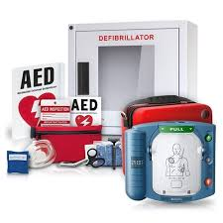
WU # 5 What is an AED? When should one be used? Why is it important?
Notes:
AED clip on image

Slide 9
WU # 5 ANSWER What is an AED? Automatic External Defibrillator When should one be used? In any cardiac emergency Why is it important? The machine will prompt the lay responder to continue performing CPR or to apply a shock-if needed.

Slide 10
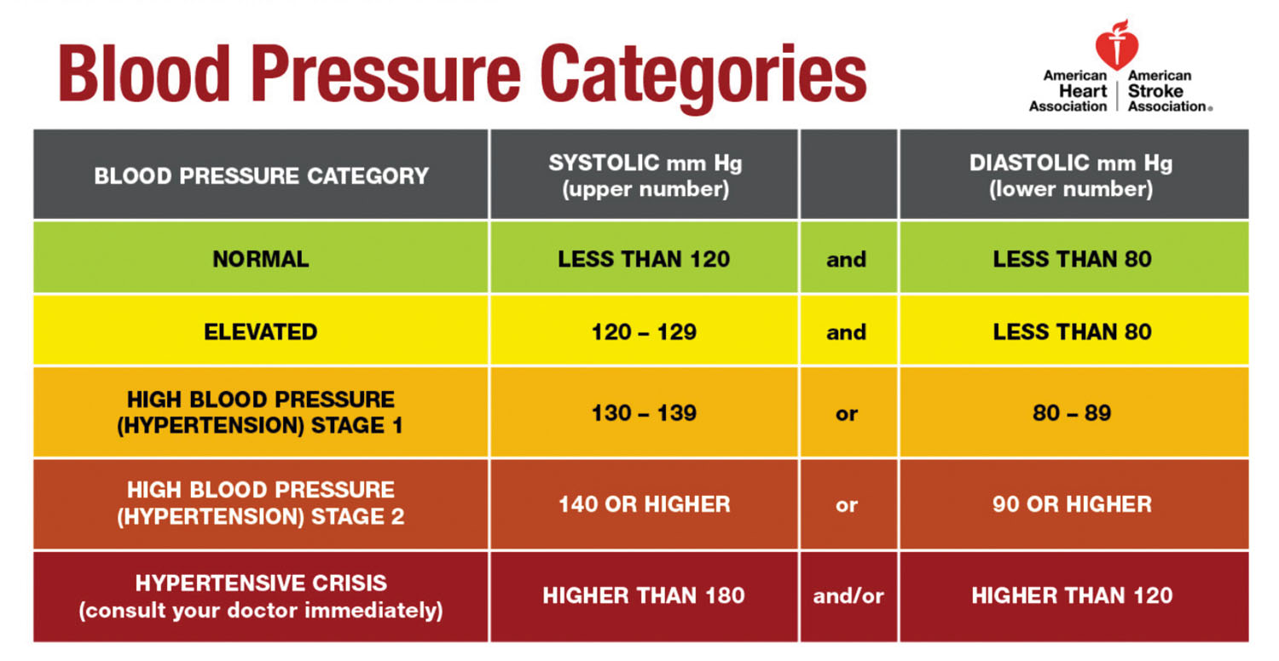
WU # 6 Define Blood pressure- What are the two readings and what do they measure?
Notes:
Blood pressure clip on image

Slide 11
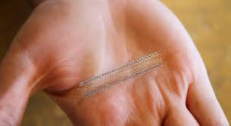
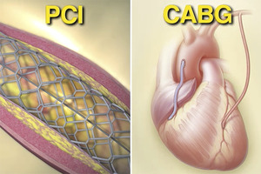
Exit Slip #7
Explain the following procedures…
a.) Angioplasty (Stent insertion)
b.) Bypass Surgery
Notes:
Video Link on image
https://www.youtube.com/watch?v=I12PMiX5h3E

Slide 12
Warm-Up #8
Explain OSHA (Occupational & Safety Health Act).

Slide 13
Worker and workplace safety. Provides workers an opportunity to work in a safe place, free from hazards.

Slide 14
Tracy Hoyle Reflection
Using complete sentences and your best writing, complete a reflection on our guest speaker from yesterday. 5-8 sentences
-What are your overall thoughts/feelings?
-What surprised you?
-What questions do you still have?
-What are some of the things you learned?
-What are your own personal feelings around organ and tissue donations?

